Slide 1
Firm Resources and Sustained Competitive Advantage
Jay Barney
Journal of Management 1991
Edited by Yue (Shego)Zhu

Slide 2
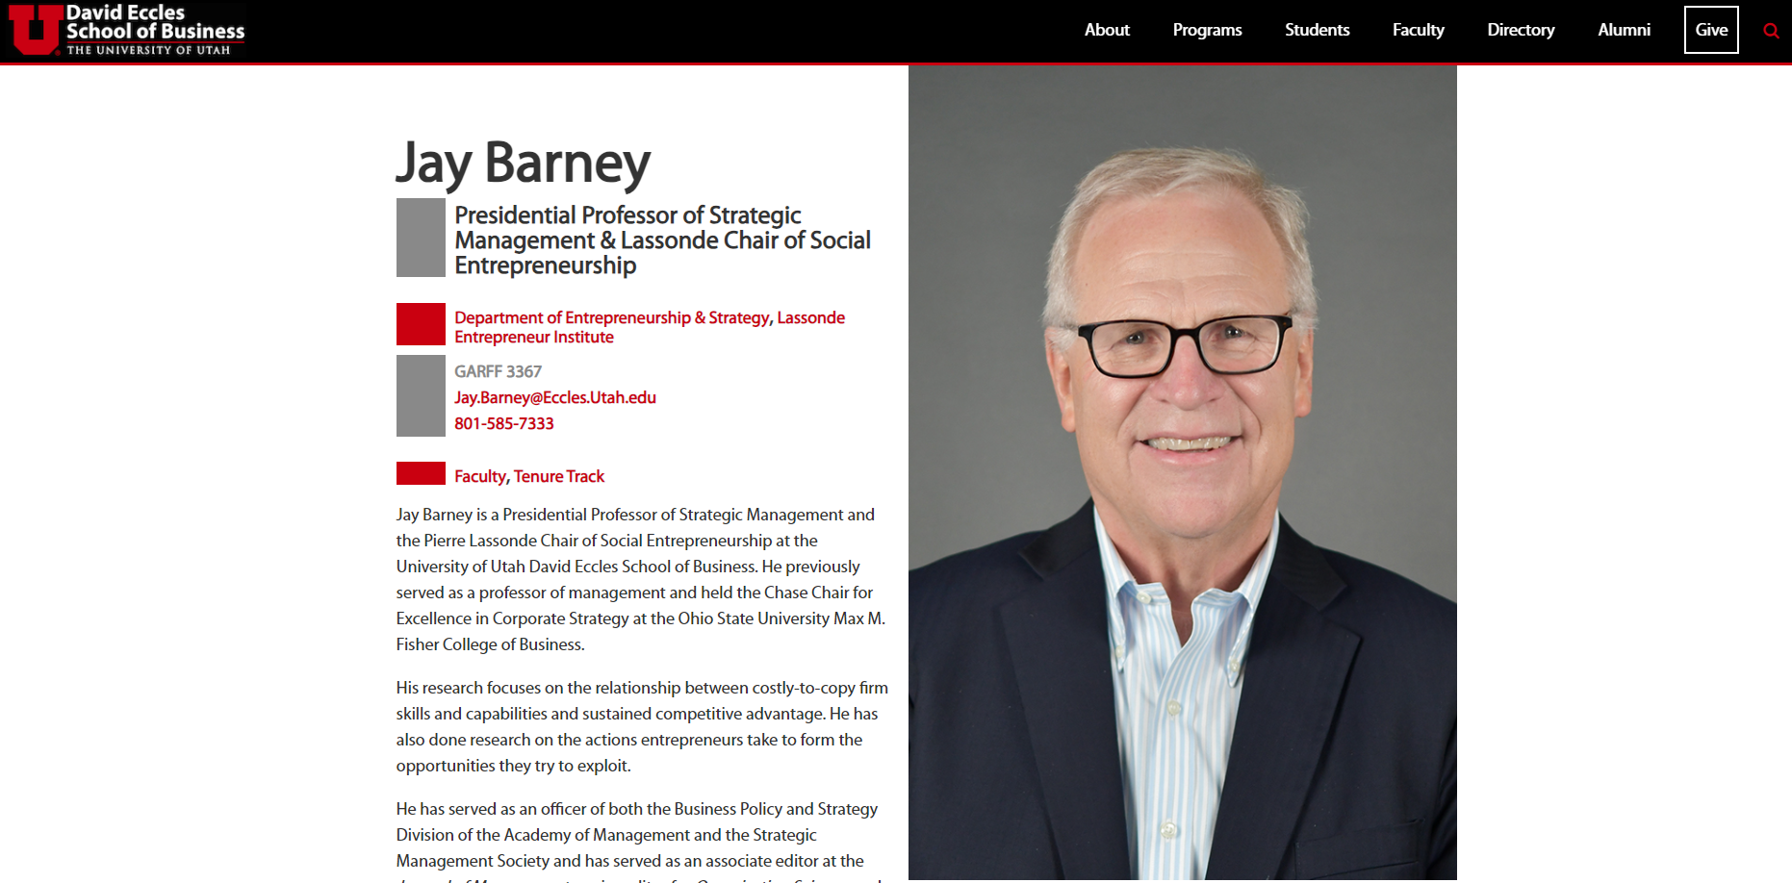

Slide 3
RESEARCH QUESTION / PROBLEM FORMULATION
Are strategic resources the source of sustained competitive advantage (SCA)? Under which conditions?
Assumptions:
Strategic resources are heterogeneously distributed across firms
Heterogeneity is relatively stable over time (resources are not perfectly mobile)

Slide 4
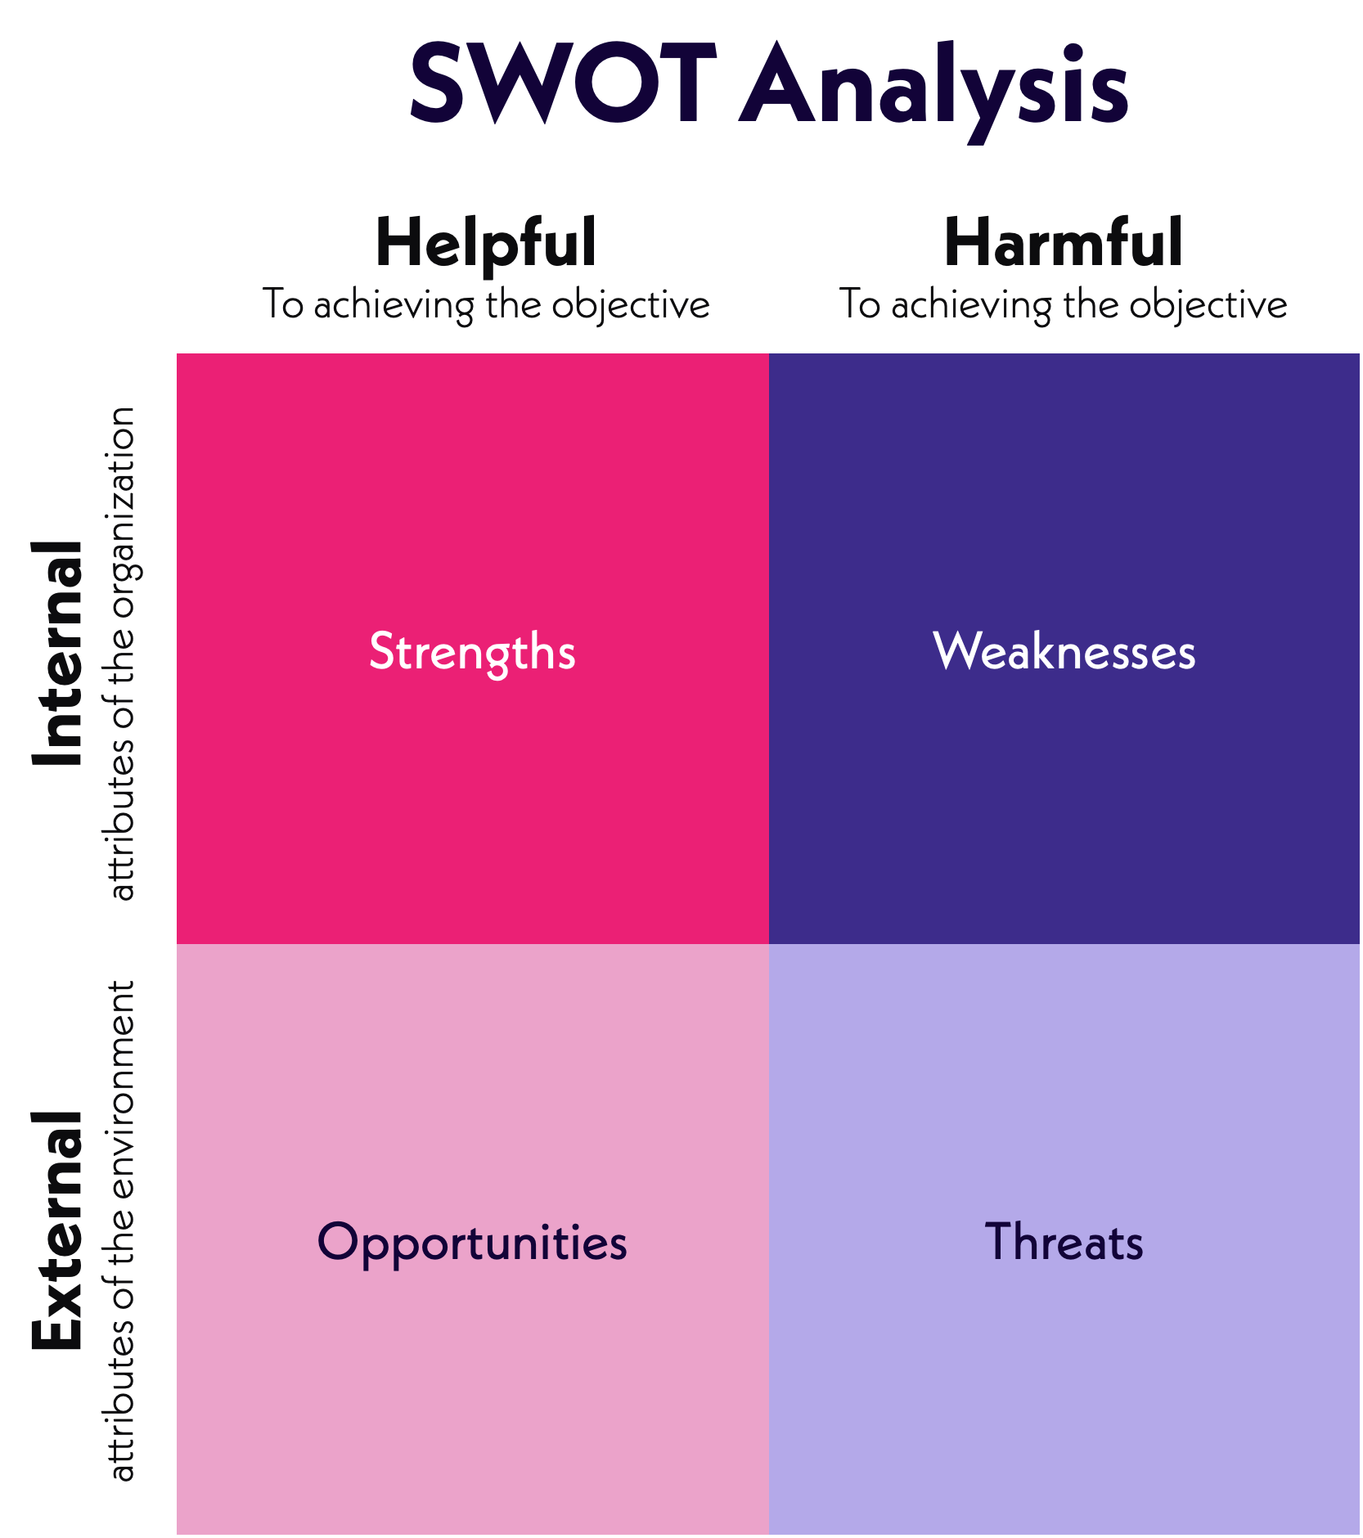
Earlier research Strengths-Weaknesses-Opportunities--Threats (SWOT) Framework:
SCA is obtained by
(1) exploiting internal strengths;
(2) avoiding internal weaknesses;
(3) responding to external opportunities;
(4) thwarting external threats;
matching these to choose strategies.

Slide 5
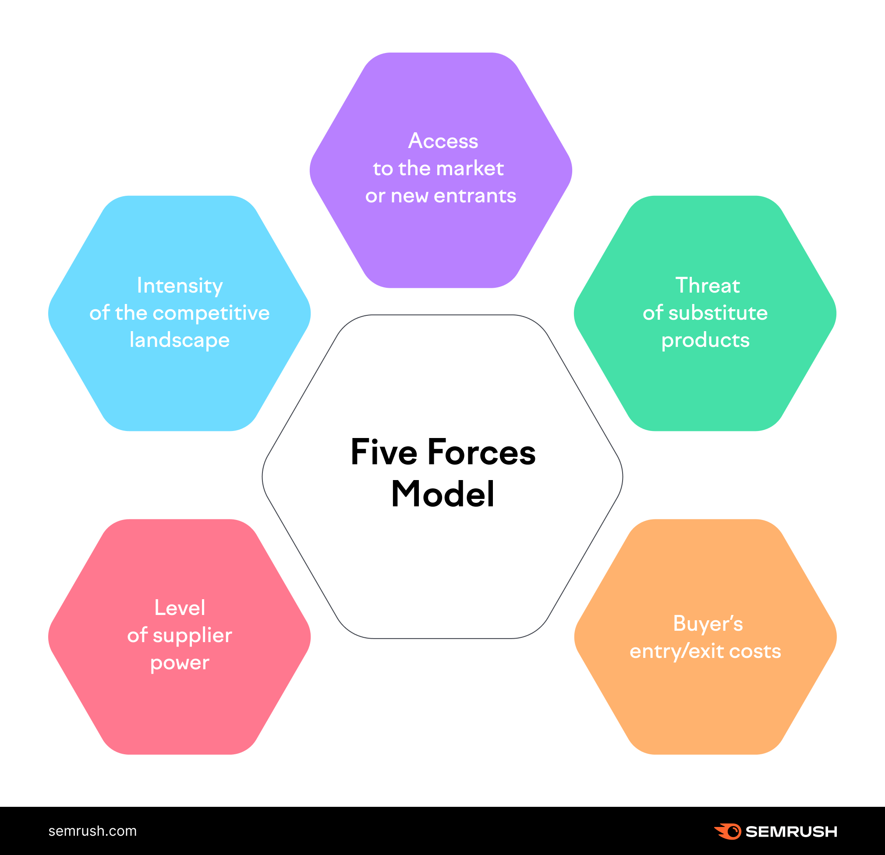
Recent research has tended to focus on opportunities and threats in its competitive environment:
Example: Porter’s (1980) Five Forces Model
Little focus on idiosyncratic firm attributes, assumes that resource heterogeneity is short-lived, and resources are mobile.

Slide 6
KEY DEFINITIONS
Firm Resources = internal strengths: broad definition that includes assets, capabilities, organizational processes, firm attributes, information and knowledge,etc(Daft,1983).
The focus of the paper is on the resources that improve efficiency and effectiveness.
  Resources = strengths that firms can use to conceive of and implement strategies
  Three categories: Physical resources, human capital resources, organizational capital resources.
Competitive Advantage: a value-creating strategy that is not simultaneously being implemented by other firms (current and POTENTIAL competitors)
Sustainable Competitive Advantage: when other firms are unable to duplicate the benefits of such a strategy.
  Not based on the period-of-time that the SCA is held
    NB: This is a math model equilibrium approach without time.
    (An alternative view with time is that SCA means to maximize NPV (time-based)

Slide 7
Search for sources of sustained competitive advantage must focus on firm resource heterogeneity and immobility.
Suppose there is an industry where all firm resources are homogenous.
Barney (1991) poses that there is no firm in such a setting that would be able to conceive and implement a strategy that could not be conceived and implemented by other firms. Thus, homogeneity implies absence of SCA.
Objections:
  First Mover Advantage: the first firm to implement a strategy can obtain a SCA (Lieberman & Montgomery, 1988).
    Counter: to generate SCA a firm must have a unique resource (information about an opportunity) enabling it to implement its strategy before others ( this is heterogeneous!)
  Entry/Mobility Barriers(Bain, 1956; Caves & Porter, 1977)
    Counter: Barriers are only possible if current and potentially competing firms’ resources are heterogeneous and not perfectly mobile(Barney, Mc Williams, Turk, 91989)
COMPETITION WITH HOMOGENEOUS AND PERFECTLY MOBILE RESOURCES
Notes:
Firms restricted from entry are unable to implement the same strategies as firms in the industry, so they must not have the strategically relevant resources or be able to acquire them easily

Slide 8
RESOURCES AND SCA
VALUABLE:
Enable a firm to conceive and implement strategies that improve efficiency and effectiveness
RARE:
Not possessed by many current or potentially competing firms
IMPERFECTLY IMITABLE due to:
  (1) unique historical conditions
  (2) causal ambiguity (the link between the firm resources and the SCA is not clear)
  (3) social complexity (interpersonal relationships, corporate culture, etc).
SUBSTITUTABILITY:
No strategically equivalent resources that are valuable but neither rare or imperfectly imitable.
  A very similar resource that enables a firm to conceive of and implement the same strategies can be a substitute
  Very different resources can also be strategic substitutes, ex. charismatic leader and formal planning system both lead to clear vision for future.
Notes:
II = firms that do not possess cannot obtain

Slide 9
BARNEY’s (1991) FRAMEWORK

Slide 10
APPLICATION OF THE FRAMEWORK
STRATEGIC PLANNING
Formal strategic planning systems are unlikely by themselves to be a source of SCA due to being highly imitable
Informal strategy-making processes are more likely to be rare and non-imitable due to being socially complex, and they may not be substitutable by formal processes.
INFORMATION PROCESSING SYSTEMS
Computers, which can be purchased, are unlikely to be a source of SCA by themselves but can be closely intertwined with a firm’s informal and formal management decision-making process.
Such a system for processing information is likely to be rare and socially complex, and even if close substitutes exist, they must be either not rare or highly imitable. (imperfectly imitable)
POSITIVE REPUTATIONS
May be imperfectly imitable based on historical conditions or social complexity(rare)
Not clear if guarantees or other long-term contracts can be a substitute(substitutability)
Notes:
II = firms that do not possess cannot obtain

Slide 11
CONNECTION TO OTHER BUSINESS DISCIPLINES
SCA AND SOCIAL WELFARE:
Firms exploit resource advantages to maximize efficiency (efficiency rents (Demsetz, 1973))
Firm do not try to create imperfectly competitive conditions in a way that fails to maximize social welfare
SCA AND ORGANIZATION THEORY AND BEHAVIOR:
SCA-generating resources include organizational and social phenomena.
The framework unites economic and organizational perspectives
SCA AND FIRM ENDOWMENTS:
Managers are limited in their ability to manipulate all the attributes of their firms. This limitation makes some resources imperfectly imitable.
Managers themselves can be the resource that generates SCA.

